Slide 1


Predicting the best location for opening a Restaurant in New York City
IBM Applied Data Science Capstone Project

Slide 2
Introduction
Opening a new business in any field is a big challenge with heavy competition everywhere. With various trending customer preferences, one must explicitly adapt to the needs of these customers. This is where data science comes into picture where an informed decision on opening any business is necessary.
In this project, an attempt to find the best location for opening a restaurant business is carried out.
Outcomes:
1. Determine the best restaurant category (Chinese, Italian, Mexican, etc.) for a new business
2. Determine the best neighbourhood to open the restaurant

Slide 3
Data Acquisition & Cleaning
The city under consideration i.e., NYC (New York City) is divided into 5 boroughs and 306 neighbourhoods. Manhattan borough is selected for its most popularity with 3071 business venues. Amongst these business, we considered Restaurant business with 816 business venues. Next, all the existing restaurant businesses and their different categorical data is obtained from Foursquare Location API Dataset. The data consists of the location, restaurant names, neighbourhood names, and restaurant categories.
Foursquare Specific Venue Dataset is also used that contains more exploratory data containing the restaurant ratings, number of reviews, total likes, and price category.
The data is further cleaned to the features of the top 10 restaurants that are most common in NYC.

Slide 4
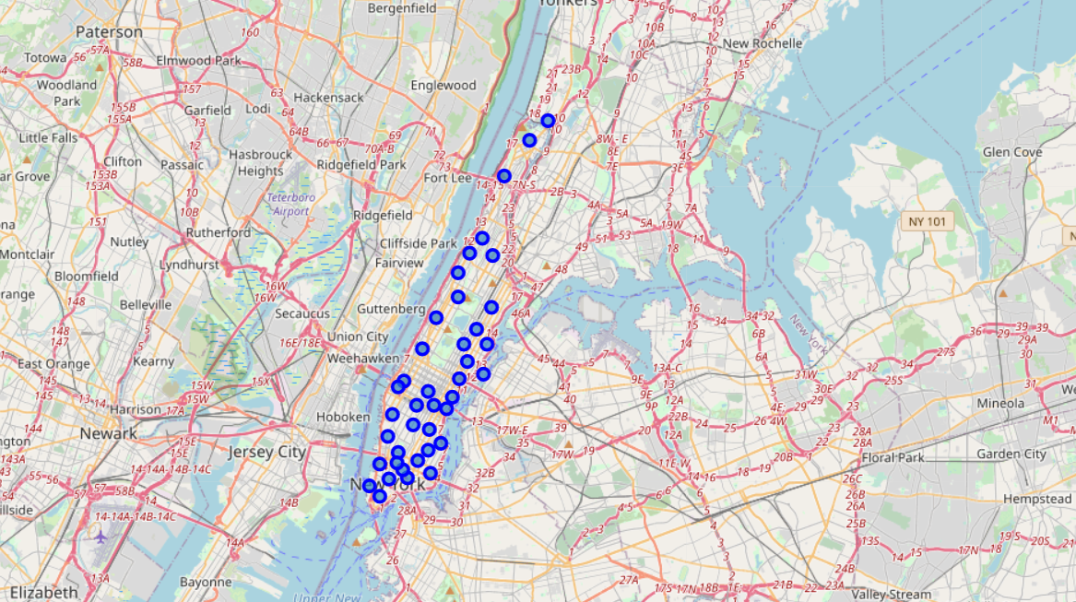
Visualizing Manhattan Neigbhorhoods

Slide 5
Neighbourhood-Restaurants Distribution

Slide 6
Top 10 Restaurant Categories in NYC

Slide 7
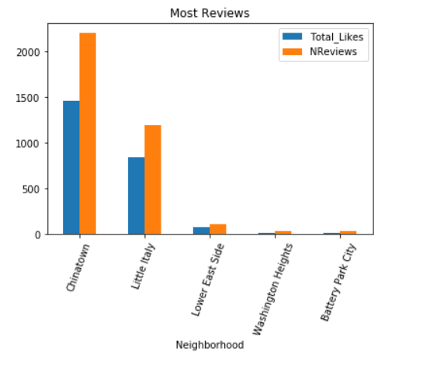
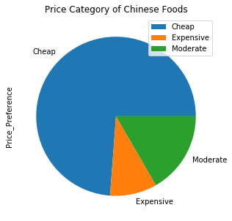
Chinese Restaurant Location
Both Chinatown and Little Italy neighbourhoods have Cheap Price Categories and dominate the Chinese Market, hence the suitable locations

Slide 8
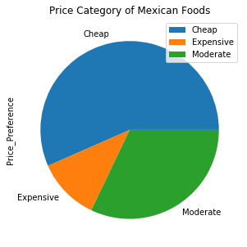
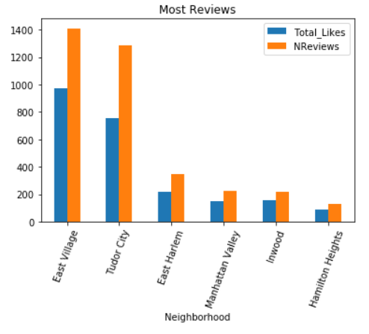
Mexican Restaurant Location
East Village is the ideal location here with most reviews, ratings, likes and also cheap.
Manhattan Valley is a potential location for its low competition, cheap price category and better in overall customer attraction than others that can prove beneficial.

Slide 9
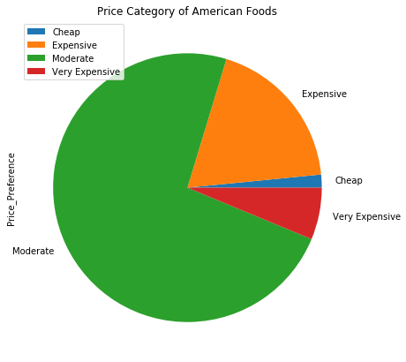
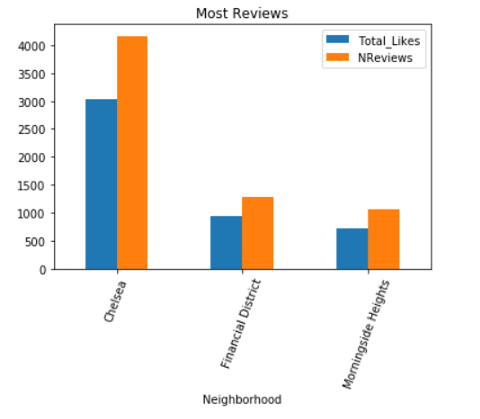
American Restaurant Location
Chelsea neighbourhood is dominant here with most reviews and likes.
For American, most of them are in moderate to expensive price category, and Morningside Heights is a potential location with 50% market in American restaurants category and less number of restaurants relatively

Slide 10
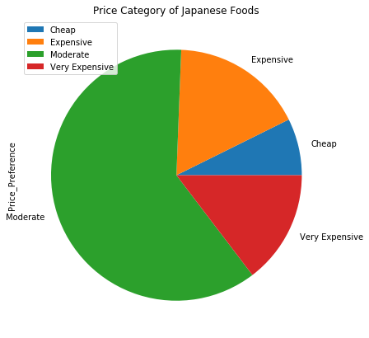
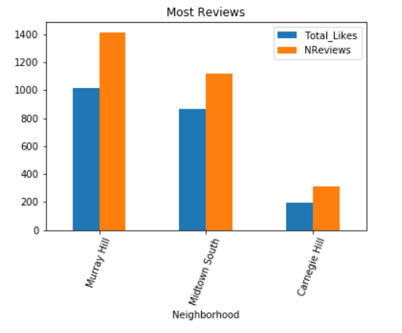
Japanese Restaurant Location
Murray Hill and Midtown South neighbourhoods have Moderate to expensive Price Categories and dominate the Japanese Market, hence the suitable locations

Slide 11
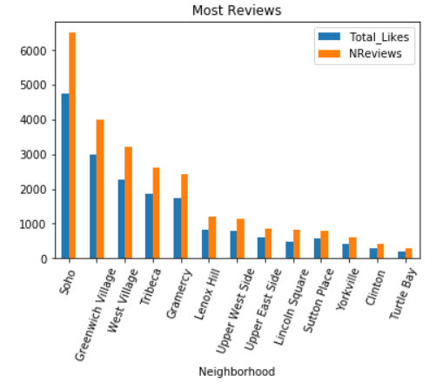
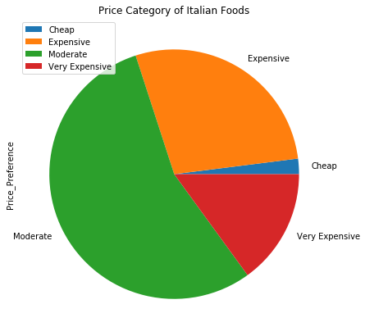
Italian Restaurant Location
Most of the Italian Restaurants are in Moderate to Expensive Price Category
Soho Neighbourhood is ideal for its most reviews and likes. (Almost double the second)
Tribeca has around 42% of its restaurant market in Italian and ranked 6th in most reviewed restaurants. Hence, it may be a potential.

Slide 12
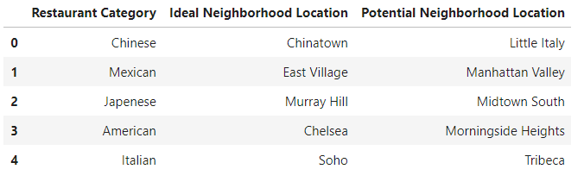
Results

